Slide 1

Housing Challenge for Seneca Hackathon
Presented by Team Nexus

Slide 2
Introduction to Housing Crisis

Slide 3
The problem
Problem statement
The Crisis is solely the product of growth and supply shortage issue.
Most major cities are experiencing this problem as strong economic growth has led to massive population growth and skyrocketing housing prices.
Despite Canada's vast land area, the population is heavily concentrated in major urban centers, leading to affordability challenges and strain on housing markets.

Slide 4
Challenges deep-dive
Challenge 1
Challenge 2
Challenge 3
Migration
Newcomers often settling in major urban centers(eg:Toronto) where housing demand is high.
Real Estate Involvement
Contributes to housing price inflation and affordability challenges, particularly in high-demand urban areas.
Unbalanced Supply and Demand
Unbalanced supply and demand in Canada's housing leads to affordability challenges, price volatility, and regional disparities.

Slide 5
Solution
A web application that utilizes a recommendation system to suggest relocation options to users based on their preferences.
• The recommendation system considers factors such as affordability, cost of living, job opportunities, climate conditions, and major attractions.
• By providing better information and clarity about housing options across Canada, we aim to distribute the population more evenly.

Slide 6
Implementation

Slide 7
Data Collection
Machine Learning Model Creation
Front End Development
Step 1
Step 2
Step 3
Step 4
Step 5
Exploratory Data Analysis
API Integrations

Slide 8
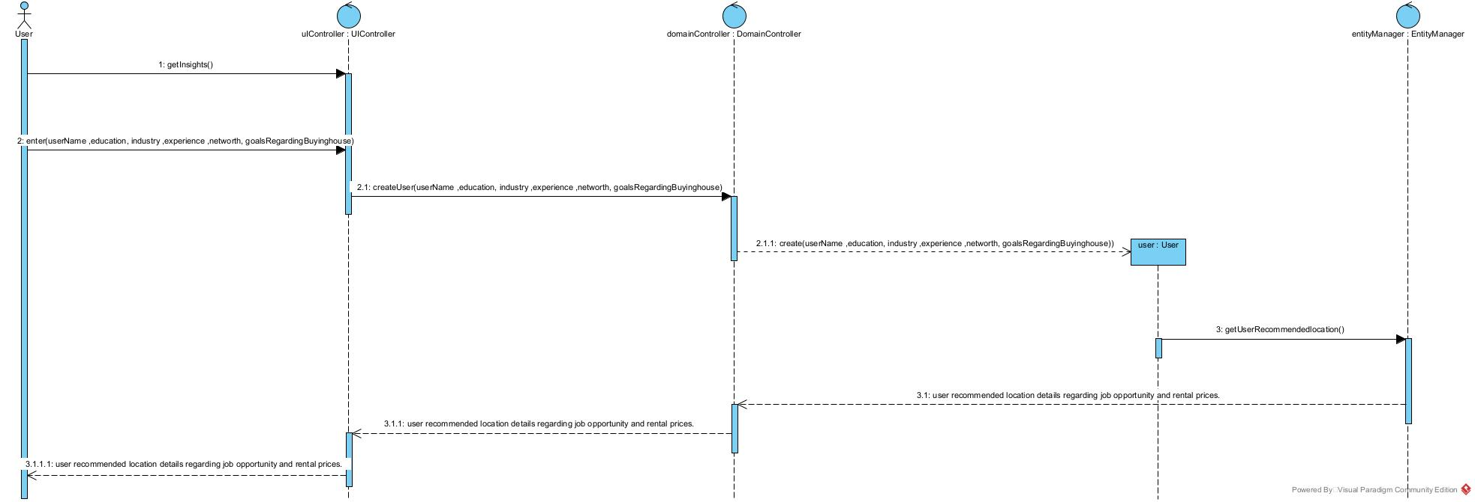
System Design Diagram
Use case 1: Location Recommendation

Slide 9
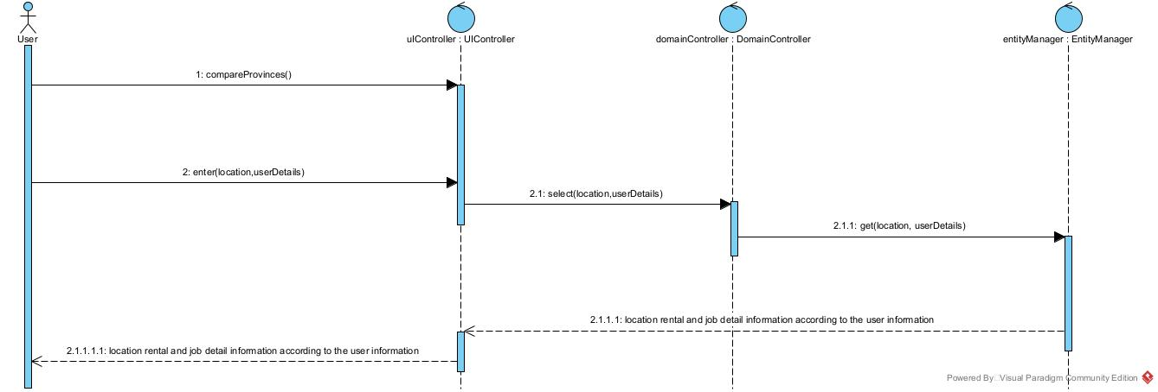
System Design Diagram
Use case 2: Comparison

Slide 10
Impact
max growth
Better opportunities, Customer satisfaction & decreased housing prices

Slide 11
Feasibility
Technical complexity in the development of the application.
The outcome requires a significant amount of time and effort initially but provides a long-lasting solution.

